Slide 1
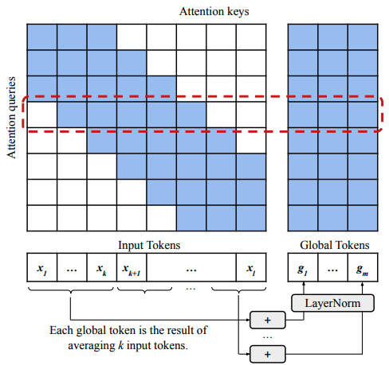
Patent Claims
Generation
Ryan Lee, Ryan Niu, Rishikesh Sivakumar, Spurthy Skandan, Joseph Wang

Slide 2
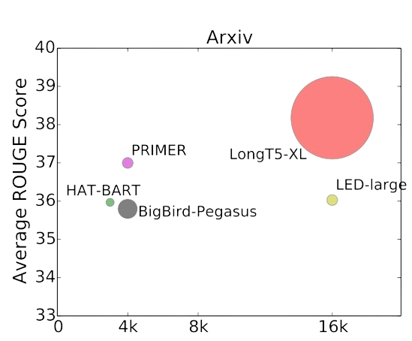
Outline
01
Introduction: Problem Definition & Motivation
02
Dataset
03
Solution- Baseline, T5 & Hybrid Models
04
Challenges
05
Results
06
Discussion
Notes:
Intro:
T5 and LongT5

Slide 3
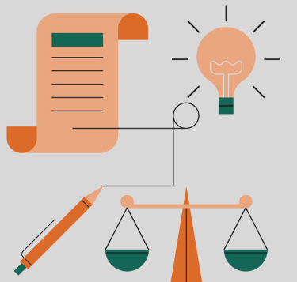
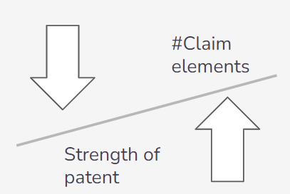

Introduction- Problem Definition & Motivation
Patent claims play a crucial role in defining the scope and boundaries of intellectual property.
Traditional manual drafting of patent claims- slow, prone to errors and requires an attorney to go through the legal language.
Automation of patent claims generation can significantly accelerate the patent application process and improve efficiency by saving time and money.

Slide 4

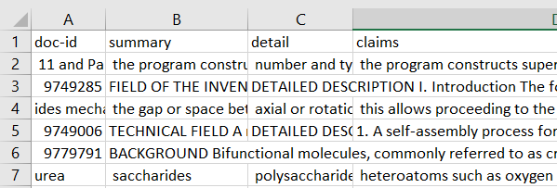
Dataset
To provide a realistic and comprehensive corpus for training and evaluating the patent claims generation system:
Patent data has been preprocessed to have summary, details and claims for each patent
Source: United States Patent and Trademark Office (USPTO).
Time Range: Patents issued from the year 2005.
Size: 10,000 patents.
Training Set: 8,000 patents, Validation Set: 1,000 patents., Test Set: 1,000 patents.

Slide 5
Solution- Baseline Models
Utilized T5 and GPT-3.5 as baseline models for the study.
Preliminary BLEU scores were derived from ChatGPT-3.5 zero-shot and finetuned performance (given description, generate claims)
Employed a conventional T5 model architecture trained with a token limit of 512.
Recognized the limitation of 512 tokens and explored the extended capability of the LongT5 model, accommodating up to 16,000 tokens for improved context retention and generation.

Slide 6
Solution- LongT5
Efficient text to text transformer for longer sequences (512 -> 2048)
Utilizes TGlobal attention mechanism
LongT5 models trained on:
16k tokens for arXiv, PubMed, BigPatent
8k for MultiNews
4k for MediaSum and CNN/Daily News
Fine-tuned with our patent dataset
Notes:
lon

Slide 7
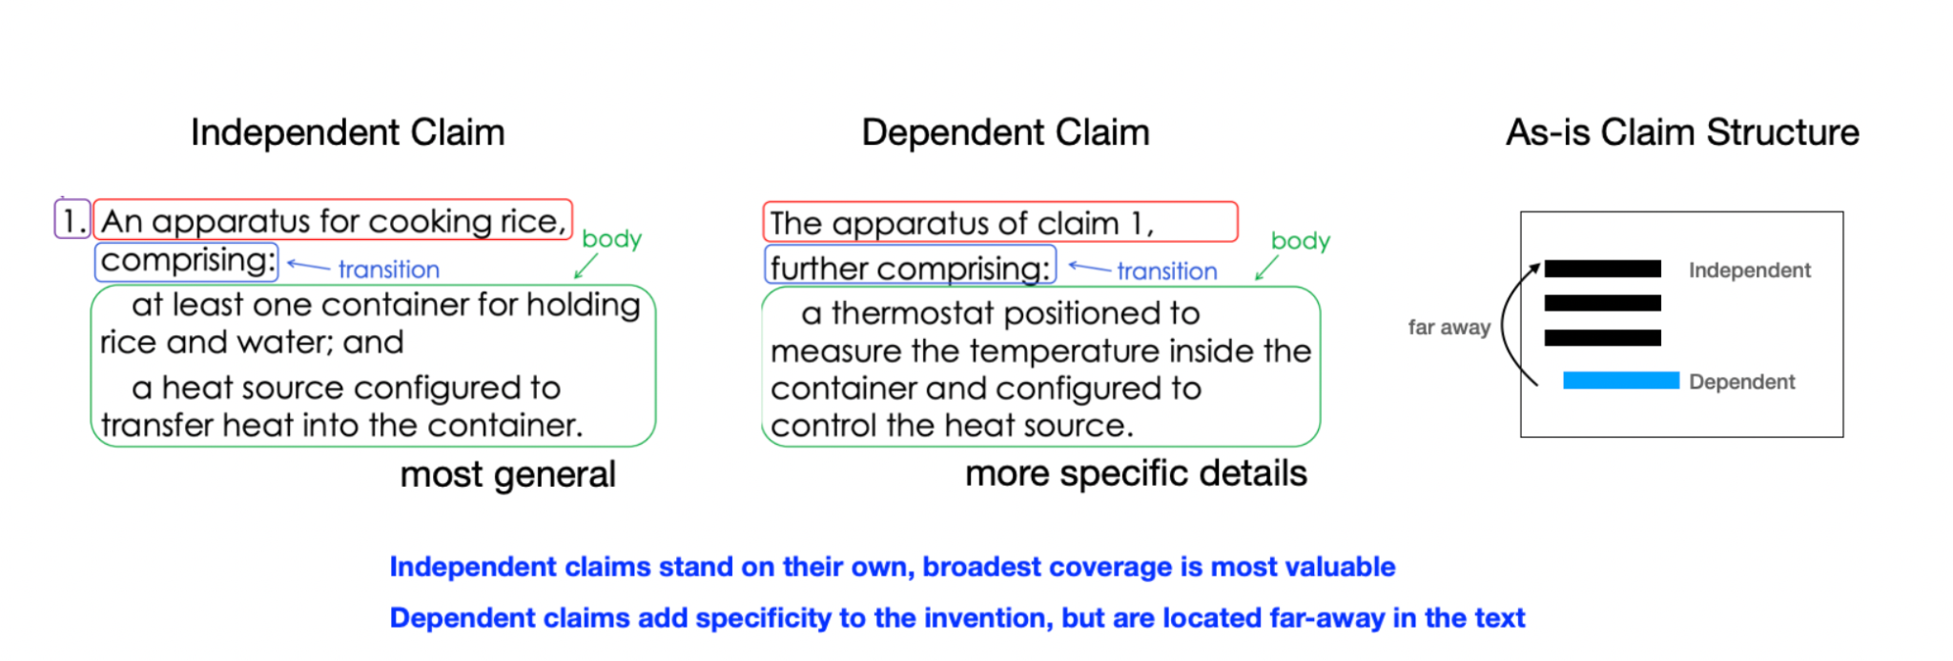
Challenges
1. Claim structure:
2. Input length: We were unable to process input lengths over 2048, even on Colab Pro. We upgrade to Colab Pro+ to increase the input text length to 6144.
3. GPU constraints: Colab Pro is also unable to accommodate LongT5-large and LongT5-xl models due to memory limitations.

Slide 8
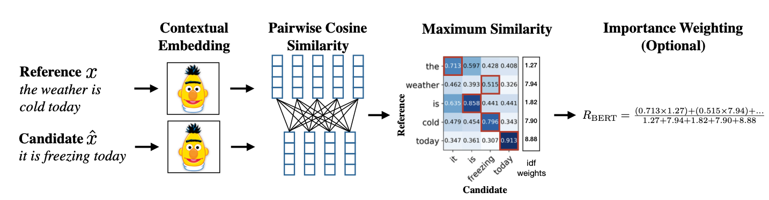
Evaluation - BLEU, Rouge, BERTScore
Precision w. BLEU - “of all generated n-grams, how many appeared in the reference” + brevity penalty
High BLEU score means most of the words generated appeared in the reference
Recall w. Rouge - “of all n-grams in the reference, how many appeared in the generated text?”
High Rouge recall means most of the words in the reference appeared in the generated text
Meaning with BERTScore - compare semantic similarity of sentences with embeddings
Q: How do we know that BERTScore is capturing semantic similarity? → Correlation with human ranking

Slide 9
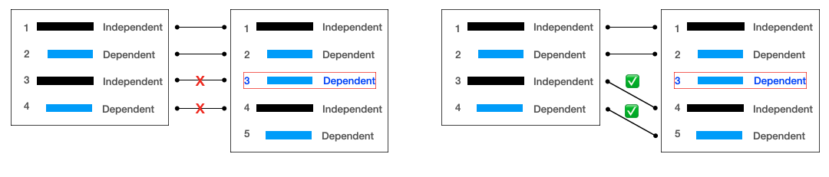
Evaluation - Sentence vs. Chunk
Sentence Alignment Problem - how to compare generated sentences to reference sentences, when the sentences might be misaligned, but order still matters?
Naive Approach - Compare by Order O(N)
New Approach - Compare by Best Alignment O(MN)
Reference Generated
Reference Generated
*modification of Needleman and Wunsch DP Algorithm for DNA sequence alignment task, optimize alignment for BLEU

Slide 10
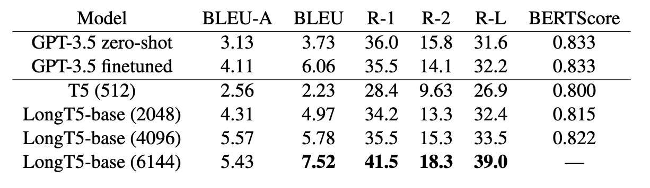
Preliminary Results
The more input context, the better the performance (3 epochs, test size 1000)

Slide 11
Preliminary Results
Can you tell the difference?
1. A safety apparatus to prevent spread of fire from a fixing chamber of a fixing station in an electrophotographic print or copy device, comprising: at openings of the fixing chamber via which a fire can spread, a sealing device that can be sealed as needed, said sealing device comprising a sealing element that cooperates with a counter-element…
1. A safety device comprising: an elastic sealing element with a sealer and a counter-element, having a series of advantages: finishing tolerances are compensated by the elastic sealer; a clamp region is achieved that can cover a length of multiple mm…
Notes:
Left is real, right is generated

Slide 12
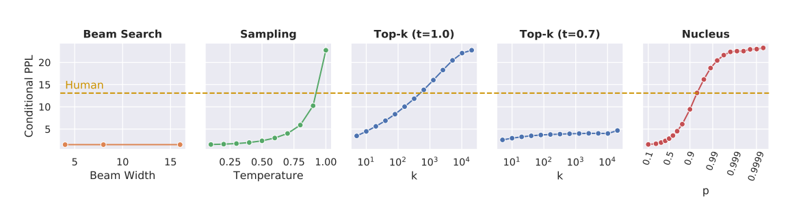
Future Work
Experiment with more training data
Experiment with even longer context lengths (8k, 16k)
Use top-k sampling or nucleus sampling to minimize redundant output
“The safety device according to claim 1, wherein the sealing element is realized as a clamp plate. 6. The safety device according to claim 1, wherein the sealing element is realized as a brush strip. 7. The safety device according to claim 1, wherein the sealing element is realized as a clamp plate…”

